Slide 1
Graph Representation
redleaf23477
(2022 Summer TA)
Han
(2023 Spring TA)

Slide 2

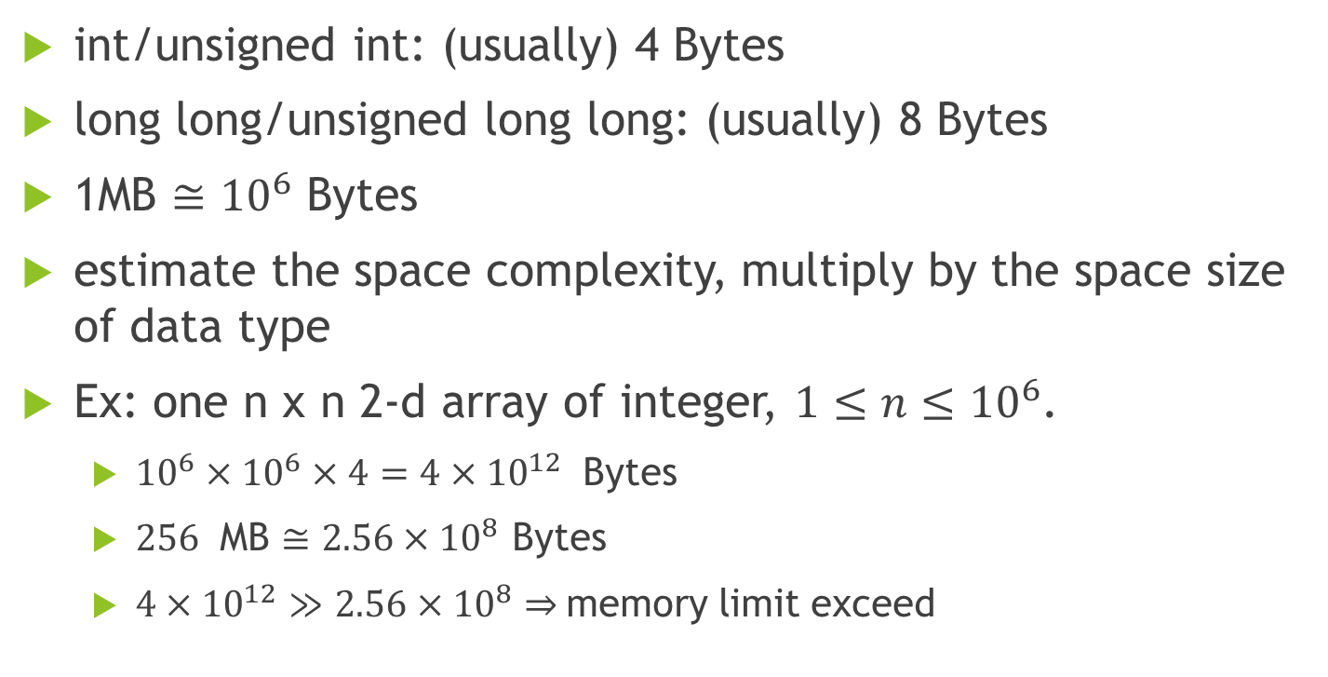
About space complexity

Slide 3
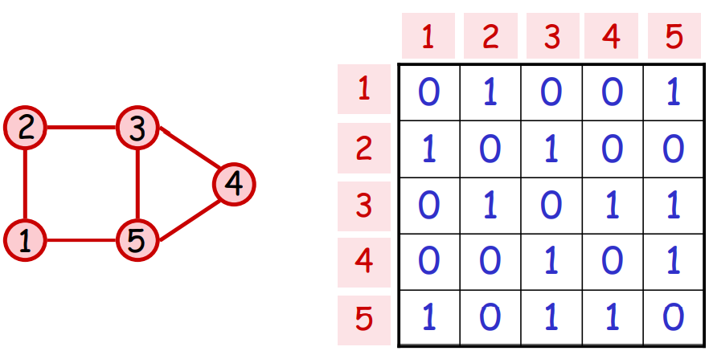
Adjacency Matrix
Using a |V| x |V| matrix A to store a undirected graph G = (V, E).
A[u][v] = 1, A[v][u] = 1, if (u, v) is an edge.
A[u][v] = 0, A[v][u] = 0, otherwise.
Using a |V| x |V| matrix A to store a directed graph G = (V, E).
A[u][v] = 1, if (u, v) is an edge.
A[u][v] = 0, otherwise.

Slide 4
Adjacency Matrix
Using a |V| x |V| matrix A to store a weighted undirected graph G = (V, E).
A[u][v] = w, A[v][u] = w, if (u, v, w) is an edge.
A[u][v] = INF, A[v][u] = INF, otherwise.
Using a |V| x |V| matrix A to store a weighted directed graph G = (V, E).
A[u][v] = w, if (u, v, w) is an edge.
A[u][v] = INF, otherwise.
INF is a specific value you defined, which should be different from any possible value during calculation.

Slide 5
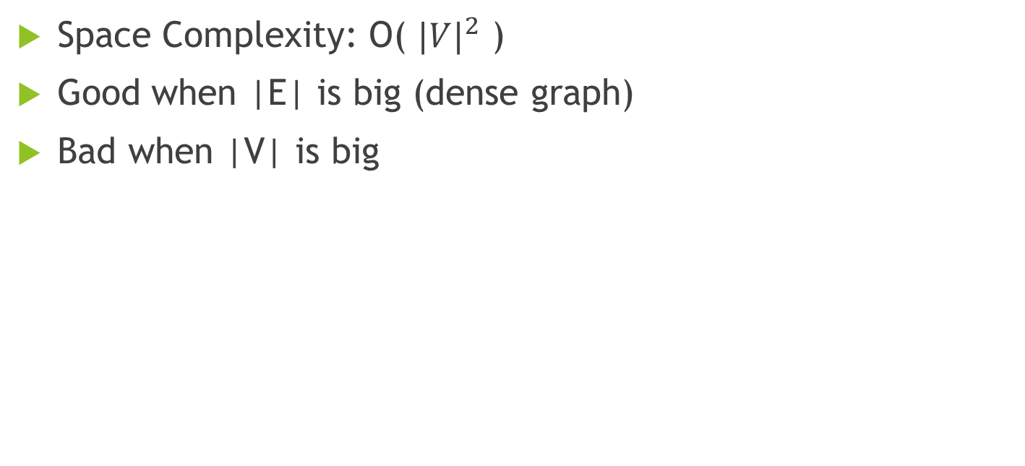
Adjacency Matrix – Space Complexity

Slide 6
Adjacency Matrix – Initialize ( |V| = n )

Slide 7
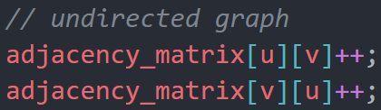

Adjacency Matrix – Insert edge(u, v)

Slide 8
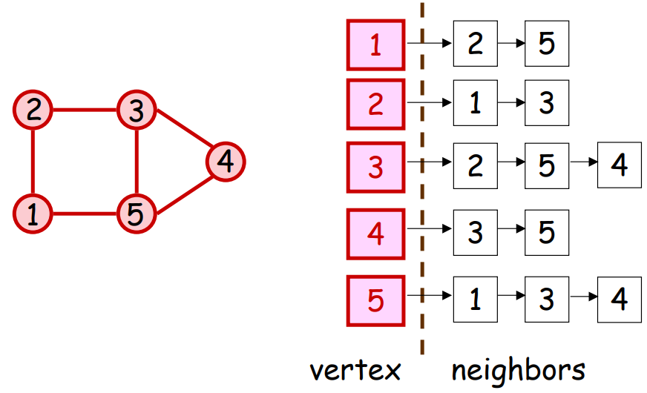
Adjacency List
For each vertex u in graph G = (V, E), store its neighbors in a list
If there is an edge (u, v) in G, put v in the list.

Slide 9
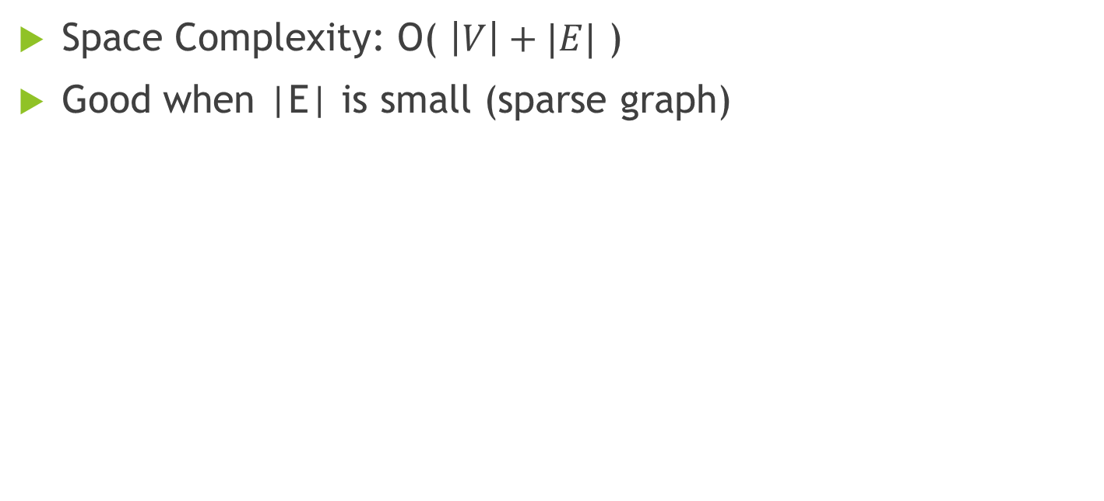
Adjacency List – Space Complexity

Slide 10
Adjacency List – Initialize ( |V| = n )

Slide 11
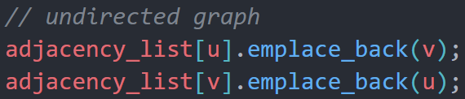

Adjacency List – Insert edge(u, v)

Slide 12
in class sample codes
adjacency_matrix
http://codepad.org/vl7e6k2z
adjacency_list
http://codepad.org/I1DJOsWL

